Slide 1
HEART FAILURE WITH PRESERVED EJECTION FRACTION
DR NIYAS K NASEER
SR CARDIOLOGY

Slide 2
65 /F
Progressive DOE and chest discomfort for 1-2 yrs (NYHA CLASS III)
Previous h/o hospitalization for HF
h/o HTN,DM and CKD
c/c AF (rate control & OAC)
Physical examination:
  BP:140/90
  JVP elevated
  pedal oedema
  LAB: NT probnp 627, cr-1.7 , Hb:11.7

Slide 3
On drugs: OAC ,Lasix , ace inhibitors , B-blockers ,statins ,OHA
ECG:AF with RBBB
ECHO: EF: 55% ,Normal LV dimensions
  LAVI:72%
  DT – 140ms , e’ =4 cm/s: E/e’ = 32
CAG: Normal coronaries

Slide 4
DIAGNOSIS ?

Slide 5
OVERVIEW
What is HF-PEF ?
How Prevalent is it?
Who are these patients?
What is the pathophysiology?
How do you diagnose it?
What is the prognosis?
How to treat it?

Slide 6
What is HF-PEF ?

Slide 7
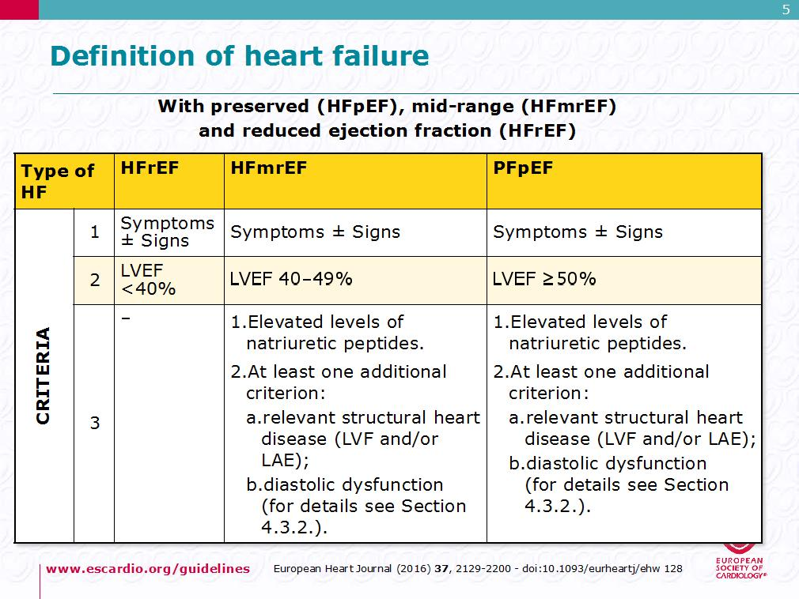
HFpEF

Slide 8
TERMINOLOGY
heart failure with a normal EF/ heart failure with normal systolic function/ diastolic heart failure / diastolic dysfunction

Slide 9
Is heart failure with preserved ejection fraction just a transitory stage in the heart failure spectrum or is it a distinct disease phenotype?
CHARM TRIALThe Lancet. 2003. 362(9386):777-781

Slide 10
How Prevalent is it?
should hfpef be addressed

Slide 11
Ejection Fraction in Subjects with CHF
-the Cardiovascular Health Study
4,842 community-dwelling elderly (>66 yr.) subjects; CHF prevalence 8.8%
80% had normal EF(>45%)
Men
Women
Normal (55%)
1
0
%
3
1
%
4
2
%
2
3
%
Mildly Reduced
(45% - 54%)
6
7
%
2
7
%
Moderately (30-44%) or severely reduced (< 30%)
Kitzman, et. al.Am. J. Cardiol. 87:413-419 (2001)

Slide 12
Prevalence HF with Preserved Ejection Fraction
15-yr FU (1987-2001) in a single center study, N= 4596. More older, female, obese, HT, Af. Less CAD and VHD EF ≥ 50%, N=2167 EF < 50%, N= 2429
Owan TE et al N Eng J Med 2006;355:251-9.Trends in prevalence and outcomes of heart failure with preserved ejection fraction. N Engl J Med 2006;355:251

Slide 13
Trends in survival of HFREF VS HFPEF
Theophilus E Owan et al N Eng J Med 2006;355:251-9

Slide 14

Prevalence of Heart Failure
USA
(CHS)
Finland
(Helsinki)
England
(Poole)
Sweden
(Vasteras)
Den.
(Copen.)
Spain
(Asturias)
Portugal
(EPICA)
Nether.
(Rotter.)
10
9
8.8
Proportion with reduced
LV ejection fraction
Proportion with preserved
LV ejection fraction
8.2
8
7.5
7
6.7
6.4
6
prevalence %
4.9
5
4.2
4
3
2.1
2
1
4.8
4.2
5.1
3.1
4.5
2.9
1.7
1.5
0
age range
mean age
66-103
78
75-86
-
70-84
76
75
75
> 50
-
> 40
60
>25
68
55-95
65

Slide 15
Changing Landscape of Heart Failure: in Hospitalized HF Pts
Get With the Guidelines-Heart Failure (GWTG-HF) Study , N=110,621, USA
using actual data on the proportion of hospitalization patients
Steinberg BA, Circulation 2012 126(1):65-75

Slide 16
Meta-analysis Global Group in Chronic Heart Failure (MAGGIC)
31 studies, N= 41,972. 10,347 with HFPEF(HFNEF) vs 31,625 with HFREF
Eur Heart J 2012 33:1750–57

Slide 17
Does heart failure with preserved ejection fraction simply represent a collection of co-morbidities rather than a pathophysiologically distinct entity?

Slide 18
Who are these patients?

Slide 19
Demographic Features
Differences in race, ethnicity, and geographic region
African Americans may develop HFpEF at a younger age
HFpEF is increased in Asians with a lean body mass and diabetes
Hypertension in majority of (80% to 90)
Obesity is seen in 30% to 50%
Diabetes in 20% to 30%
Atrial fibrillation (AF) in up to 20% to 30%, and a history of AF in about 50% of patients
high prevalence of renal disease
CAD is 20% to 40%

Slide 20
COMORBID CONDITIONS- heterogeneous clinical syndrome
AGE- decrement due to slower rates of LV relaxation, changes in the pattern of LV filling, and reduction in the early diastolic annular velocity that slowly progress with age
SEX-Females are at potent risk
HYPERTENSION - concentric remodeling or overt LV hypertrophy, increasing arterial and ventricular systolic stiffness -> impaired relaxation and increased diastolic stiffness

Slide 21
CAD - guidelines recommend revascularization in those patients with HFpEF in whom ischemia is felt to contribute to diastolic dysfunction
Atrial Fibrillation and Other Rhythm Disturbances:
Obesity
Diabetes mellitus - contributes to structural and functional coronary vascular and myocardial changes include metabolic disturbances, activation of proinflammatory and profibrotic mediators, cardiac autonomic neuropathy, and increases in advanced glycation end products (AGEs) -> promote increased collagen accumulation and stiffness

Slide 22
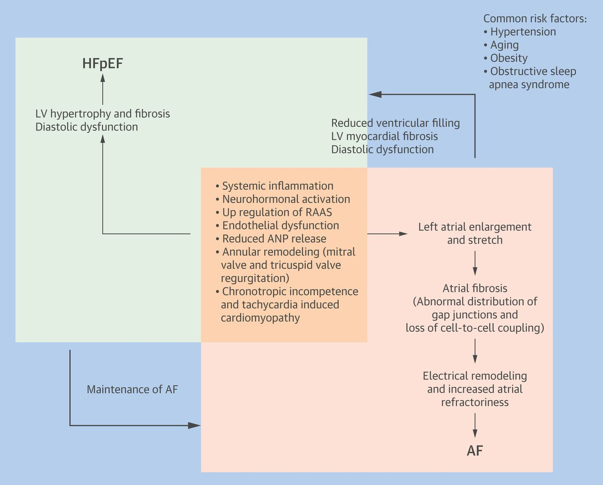

Slide 23
CKD
SLEEP APNOEA
PULMONARY ARTERY HYPERTENSION – prognostic implications and is associated with higher morbidity and mortality rates
OTHER RARE –infiltrative CM , valvular disease , constrictive pericarditis

Slide 24
Characteristics of Patients with Reduced and Preserved LVEF
Baseline Variables
Reduced EF
Preserved EF
P-value
(<40%, n=1570)
(>50%, n = 880)
Mean LVEF %
25.9
62.4
<0.001
Age-years
71.8 ± 12
75.4 ± 11.51
<0.001
Female (%)
37.4
65.7
<0.001
Coronary artery disease (%)
48.7
35.5
<0.001
Angina (%)
28.0
22.8
<0.005
Prior myocardial infarction (%)
39
16.6
<0.001
Prior CABG (%)
12.9
5.8
<0.001
Hypertension (%)
84
91
<0.001
Diabetes (%)
38.9
31.7
<0.001
Atrial Fibrillation (%)
23.6
31.8
<0.001
COPD (%)
13.2
17.7
<0.002
Hemoglobin <10 g/dl (%)
9.9
21.1
<0.001
Systolic blood pressure-mm Hg
146
156
<0.001
Bhatia et al. NEJM 2006;355:251-9

Slide 25
ADHERE Registry
Preserved ejection fraction (n=26,322)
Age 74
Women % 62
Hypertension % 77
CAD % 50
MI hx % 24
SBP>140 % 61
SBP (mmHg) 152
A Fib % 21
COPD/Asthma % 31
Reduced ejection fraction (n=25,865)
Age 70
Women % 40
Hypertension% 69
CAD% 59
MI hx % 36
SBP>140 % 44
SBP (mmHg) 139
A Fib% 17
COPD/Asthma 27
JACC 2006;47:76-84

Slide 26
What is the pathophysiology?

Slide 27
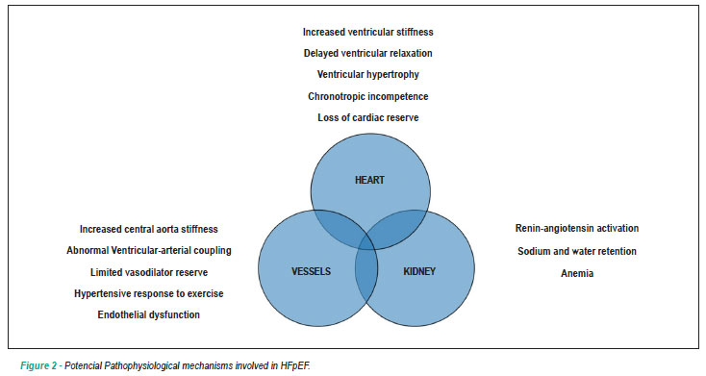

Slide 28
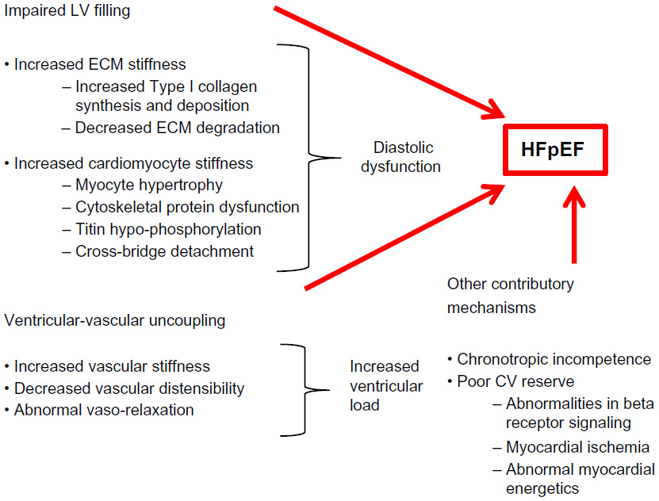

Slide 31
Notes:
Antecedent and comorbid diseases → hemodynamic and metabolic load → sympathetic and RAAS activation and parasympathetic suppression → create a pro-inflammatory and profibrotic milieu as evidenced by changes in typical plasma biomarkers

Slide 32
Notes:
Proinflammatory and profibrotic signaling effects recruitment of circulating hematopoietic progenitor cells, alters endothelial function, and increases reactive oxygen species, all of which in turn alters extracellular matrix (ECM) homeostasis that favors fibrosis and cardiomyocyte mechanisms including calcium and energetic regulation, myofilament
structure and function, and intracellular signaling. In aggregate these changes in the ECM and cardiomyocyte result in abnormal diastolic function and promote the development of HFpEF

Slide 35
Physiology of Diastole
Diastolic phase- LV relaxation and LV filling.
LV relaxation- Start of relaxation and reduced ejection
Iso volumetric relaxation
LV filling- Rapid phase -70% to 80%
Slow filling(diastasis) -less than 5%
Atrial systole -15% to 25%
LA functions as Reservoir during systole- conduit during early diastole and pump during late diastole

Slide 36
Determination of LV Diastolic function
Ventricular relaxation and compliance-Haemodynamic load (afterload)
Synchrony
Cellular mechanisms
LA volume and function
Heart rate
Pericardium
Derangement of any of the above will lead to abnormal filling pressures and diastolic dysfunction.

Slide 37
Left Ventricular Relaxation
an active energy-dependent process
begins with the decay of force-generating capacity , follows the completion of the ejection phase of systole, and continues through isovolumic pressure decline and the rapid filling phase
Estimation:
IVRT.
Maximum rate of pressure decline dp/dt (iso volumetric pressure decay)
Time constant of relaxation or tau

Slide 38
IVRT
Time interval between Aortic valve closure and mitral valve opening
Provides insight into the rate of early diastolic LV relaxation
Affected by heart rate and arterial pressure
increased by an elevation of aortic pressure or decreased by an increase in LA pressure
Relaxation is prolonged, mitral valve opening is delayed and hence IVRT is increased
≤70 in normal subjects

Slide 39
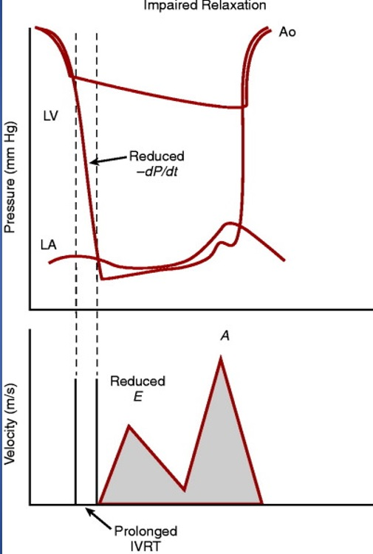
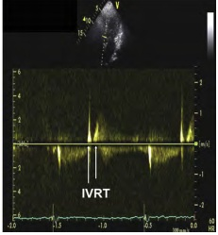

Slide 40
Iso volumetric pressure decay
Simplest way is to measure the rate of pressure fall is dp/dt
Altered by changes in loading conditions
After load dependent
Increase in -dp/dt signifies increase in myocardial relaxation or rise of aortic pressure.
HfpEf have larger -dp/dt signifying that relaxation rate is decreased

Slide 41
Tau and Time constant of Ventricular relaxation
Described in 1976 by Weiss et al.
Best index to evaluate left ventricular diastolic function, available traditionally in cath lab
Time constant T (tau) describes the rate of LV pressure decline throughout isovolumic relaxation
LV pressure(dp/dt) = P₀e-^{t/τ} where P₀ is LV pressure at end ejection and τ is the exponential time constant
The larger the value of τ, the longer it takes for the LV pressure to fall and the more impaired is relaxation
A normal value for τ is less than 40 milliseconds in most age-groups, suggesting that relaxation is nearly complete by 3.5 × τ (<140 milliseconds)

Slide 42
Recoil and Left Ventricular Filling
During relaxation, potential energy is released as the elastic elements recoil and return to their original length and orientation.
Recoil causes LV pressure to fall rapidly during isovolumetric relaxation
fall in LV pressure produces an
early diastolic pressure gradient
from the left atrium that extends to
the LV apex

Slide 43
Determinants of LV filling
Early Filling
Late filling
Preload
Trans mitral flow rate
Atrial Pressure
Cardiac rhythm
Atrial contractile function
Ventricular end diastolic pressure.

Slide 44
Left Ventricular Diastolic Stiffness, Compliance, and
Distensibility
The passive characteristics of the left ventricle during diastole can be described by the passive diastolic pressure-volume relationship (DPVR)
Left ventricular stiffness is defined as the ratio of LV diastolic pressure and LV diastolic volume (LV dP/dV) at any given LV diastolic volume
Left ventricular compliance is the reciprocal of stiffness (LV dV/dP)
Left ventricular diastolic distensibility is defined as the end-diastolic pressure required to distend the left ventricle to an end-diastolic volume
Patients with HFpEF have reduced distensibility, indicated by a normal or reduced end-diastolic volume and an elevated end-diastolic pressure

Slide 45
Estimation of Left Ventricular Stiffness
Stiffness will increase as the left ventricle fills to higher LV diastolic volumes; thus as the left ventricle fills, it becomes stiffer.
DPVR can be approximated by an exponential function, its position and shape can be described by the constants within an equation such as the following: P =  × e^{βV}, where α and β represent the “stiffness constants.”
β does not indicate stiffness but instead describes how rapidly stiffness increased with increases in volume (β = [dP/dV]/V).
Stiffness constants derived in this fashion can be used to compare passive diastolic properties in different patients or patient groups.

Slide 46
Diastolic pressure-volume relationship (DPVR) in patients with HFpEF is shifted upward and to the left → for any given LV volume, pressure is higher in HFpEF, indicating decreased distensibility (increased stiffness)
In patients with HFrEF, the DPVR is shifted to the right,indicating increased distensibility

Slide 47
Four groups : patterns of DPVR
Notes:
Among patients with heart failure and an increased LV diastolic pressure, four patterns of diastolic pressure-volume relationship (DPVR) .HFpEF may be characterized by graphed curves A and B. In the most prevalent pattern in HFpEF, represented by curve B, the DPVR is shifted upward and to the
left, indicating reduced distensibility, where LV pressure is increased at any LV volume. In patients with HFpEF, when relaxation is markedly prolonged and diastole is abbreviated, as shown in curve A, LV diastolic pressure falls throughout diastole but remains increased. In curve C, pericardial constraint causes a parallel upward shift in the DPVR. DPVR in patients with HFrEF typically is characterized by
curve D, in which eccentric remodeling results in a shift of the DPVR to the right, representing an increase
in distensibility. It should be recognized that although the ventricle is more distensible, the end-diastolic
volume in these patients typically is very large and the end-diastolic stiffness in the operating region is
high

Slide 48
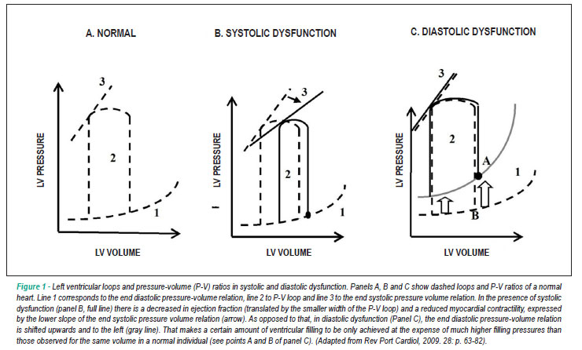

Slide 49
In heart failure with reduced ejection fraction, administration of arterial vasodilators results in minimal drop in blood pressure and substantial improvement in stroke volume
In contrast, the steeper end-systolic pressure–volume relationship in heart failure with preserved ejection fraction results in more exaggerated drops in blood pressure with vasodilator therapy, with potential reduction in stroke volume

Slide 50
Two of the determinants associated with an upward and leftward shift of the DPRV in patients with HFpEF are
presence of LV and cardiomyocyte concentric remodeling and hypertrophy
changes in the material properties of myocardial muscle itself (i.e., myocardial stiffness)

Slide 52
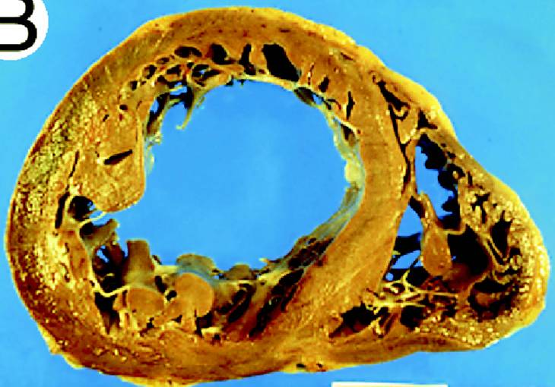
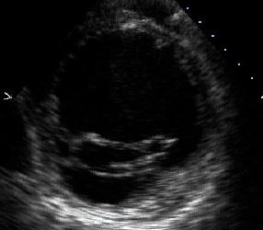
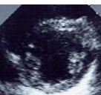
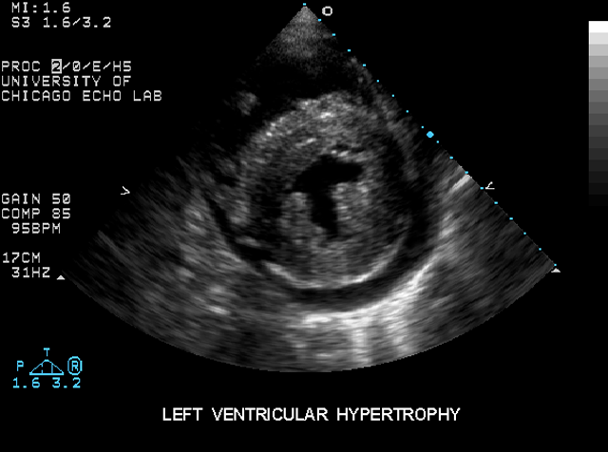
Systolic
Heart Failure
Normal
Diastolic
Heart Failure
Aurigemma, Zile, Gaasch
Circulation 2005

Slide 54
PHENOTYPES

Slide 55
How do you diagnose it?
Diagnosis of HF-PEF – 5 STEP

Slide 58
CLINICAL EVIDENCE OF HF
reduced exercise tolerance, dyspnea on exertion, orthopnea, paroxysmal nocturnal dyspnea, peripheral edema
displaced LV apical impulse and pulsus alternans presumed to be present only in HFrEF
pulmonary congestion apparent on chest radiographs or computed tomography (CT) scans
no clinical features (symptoms, signs, or chest radiograph findings) can be used to reliably
determination of the EF and LV end-diastolic volume required

Slide 59
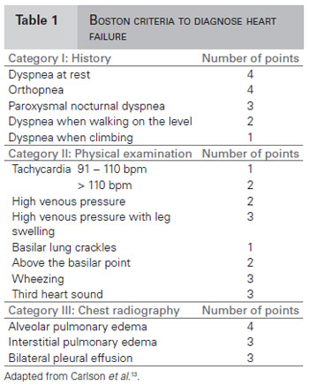
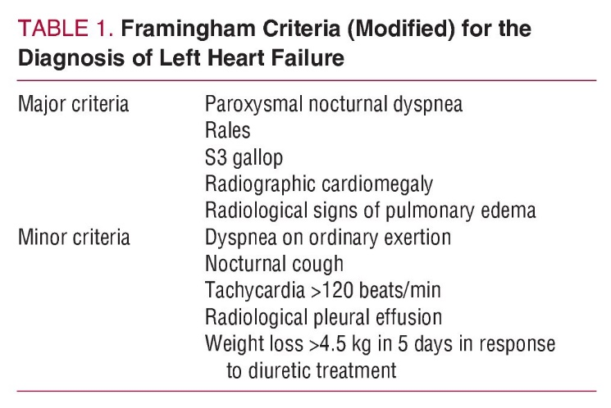

Slide 60
Biomarkers
BNP and NT-proBNP
lower than in patients with HFrEF-smaller LV cavity and thicker LV walls - end diastolic wall stress is less
increased BNP is directly related to LV diastolic filling pressure and end diastolic wall stress
lower in obese patients and higher in women, older persons, and patients with concomitant pulmonary disease (chronic obstructive disease, pulmonary hypertension, pulmonary embolus) and renal dysfunction
The standard partition values for BNP of 100 pg/mL and for NT-proBNP of 400 pg/mL have been suggested
New FDA–approved biomarkers (e.g. soluble ST2, galectin 3), as well as others still under development (e.g., TIMP-1)

Slide 61
Baseline of NT-proBNP have prognostic value in
HFpEF patients
I-Preserve study. Eur J Heart Fail 2015;17:809-17

Slide 62
Acute Decompensated Heart Failure in Patients with HFpEF
minimally symptomatic between episodes of ADHF
caused by pulmonary congestion that accompanies increases in LV diastolic filling pressure
HFpEF can result from increased filling pressure with or without significant changes in total blood volume, or LV diastolic volume In contrast, increased LV diastolic pressure and volume can result from increases in total intravascular volume or shifts of intravascular volume due to splanchnic Vasoconstriction
mechanisms include worsening diastolic dysfunction, increased neurohormonal activation, and poorly controlled comorbid disease
Notes:
Decreased LV diastolic function and abnormal LA function can result in neurohormonal activation, which plays an important role in ADHF by increasing sodium and water retention, venous return, splanchnic tone, and arterial vasoconstriction.

Slide 63
increase in pressure occurs with the development of acute decompensated heart failure (ADHF) necessitating hospital admission
baseline LV diastolic filling pressure and changes in filling pressure are sensitive predictors of future ADHF events
Zile MR et al.. Circ Heart Fail 2017;10[1].)

Slide 64
Clinical Assessment of Left Ventricular Structure
Left Ventricular Volume = An LV volume less than 75 mL/m2 is one of the guidelines-based diagnostic criteria for HFpEF
Left Ventricular Mass - LV mass is increased and reaches criteria for LV hypertrophy in 30% to 50% of patients
Left Ventricular Geometry - ratio of LV mass to volume (M/V), or of LV wall thickness to LV internal dimension (relative wall thickness [RWT]), describes the geometry of the left ventricle - concentric
remodeling

Slide 65
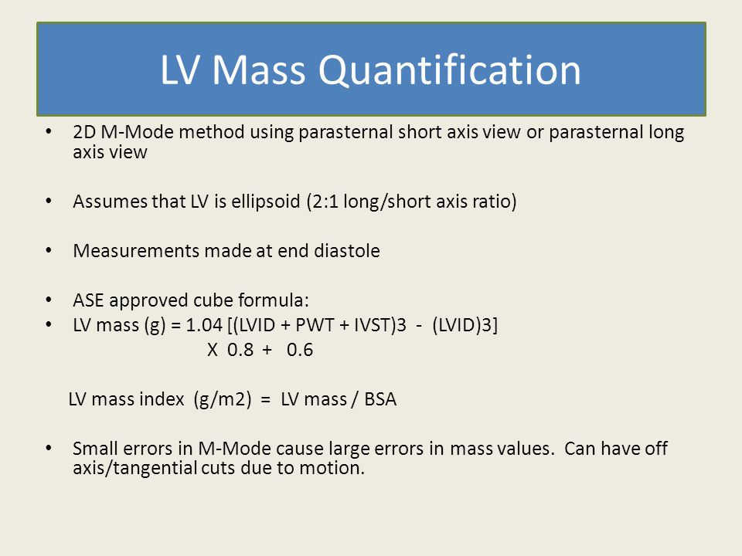
LVMI

Slide 66
LV Hypertrophy
Concentric hypertrophy or remodeling can be observed in Diastolic HF
Eccentric LV hypertrophy in depressed Efs
MC cause- Hypertension as it causes LVH
LV mass best measured by 3D echo but in 2D echo at least LV thickness should be measured.
LV wall thickness should be measured to arrive conclusions on LV diastolic function.
Relative wall thickness = PW+IVS/LVID
Relative wall thickness ≥0.42 used as threshold for pathologic LVH

Slide 67
LA Volume
Feasible and reliable
Bi Plane method
Apical 4-chamber and 2-chamber views
Signifies cumulative effect of increased filling pressures
Normal- 16-34 ml/m²
LA volume index >34 mL/m² is an independent predictor of death, heart failure, atrial fibrillation, and ischemic stroke in diastolic dysfunction
False results- Bradycardia, anemia and other high-output states, atrial flutter or fibrillation, and significant mitral valve disease.

Slide 68
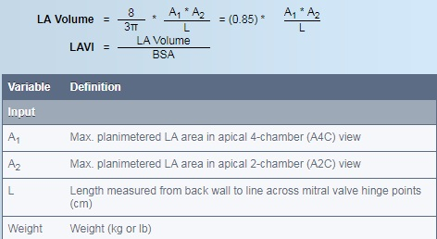
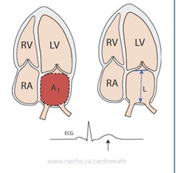
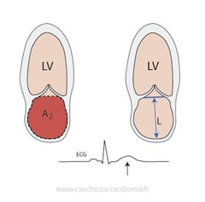

Slide 69
LA function
Functions as reservoir, conduit and pump.
Ventricular systole and isovolumic relaxation, when the atrio ventricular (AV) valves are closed, atrial chambers work as distensible reservoirs.
Pumping chamber, which contributes to maintaining adequate LV end-diastolic volume.
Reservoir volume=LA passive emptying volume -blood flow reversal in the pulmonary veins with atrial contraction.

Slide 71
Classification of diastolic dysfunction
Grade 1 : ( Mild) Impaired relaxation with normal filling pressure.
Grade 2 : (Moderate) Pseudo normalized mitral flow pattern.
Grade 3 : (Severe Reversible) Reversible restrictive with high filling pressure.
Grade 4 : (severe Irreversible) Irreversible restrictive with high filling pressure.

Slide 73
Grade 1: ( Mild)Impaired relaxation with normal filling pressure
Earliest abnormality is impaired relaxation
Mild diastolic dysfunction with slow LV relaxation
Haemodynamically causes delay in the LV pressure curve during iso volumetric relaxation
Prolongs IVRT
Rate of deceleration of early mitral flow decreases thereby DT is prolonged
Mitral flow during atrial systole increased
Filling pressures are normal

Slide 74
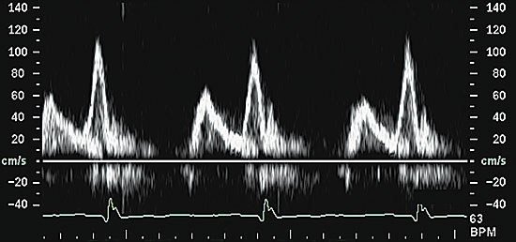

Slide 75
Grade 2 : (Moderate)Pseudo normalized mitral flow pattern
increase in LA pressure and there is restoration of the early diastolic pressure gradient despite increased early diastolic LV pressures
E wave to return to normal range (pseudonormal mitral inflow pattern)
Displacement of the left ventricle onto a steeper
portion of the pressure-volume curve results in a shortening of the DT.
slower relaxation, the e′ is delayed, occurring after the E
Pulmonary venous flow shows diastolic predominance

Slide 76
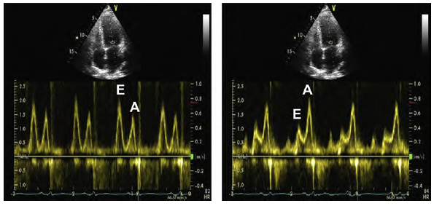

Slide 77
Grade 3 : (Severe Reversible) Reversible restrictive with high filling pressure.
markedly slowed relaxation and elevated LA pressure
E increases further, DT becomes very short, and e′ is further reduced and delayed resulting in a marked elevation of E/e
In severe diastolic dysfunction, the late diastolic annular velocity (a′) also may be reduced
Pulmonary venous flow shows diastolic predominance with prominent flow reversal.
Ar-A is prolonged (>30).
Reversibility.

Slide 78
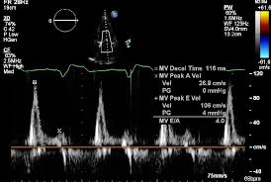

Slide 79
Grade IV
Irreversibly restrictive.
Preload manipulation no longer leads to improvement in filling pattern.
Maintaining precarious balance between volume overload and hypoperfusion can be difficult.

Slide 80
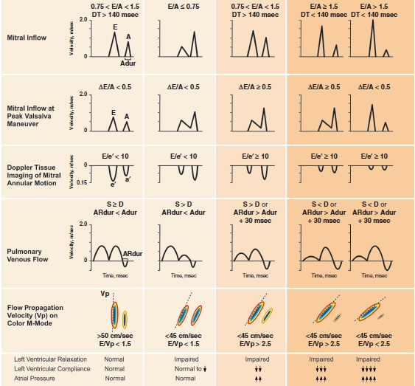

Slide 81
E/e′
most frequently used parameter to estimate LA pressure
LAP = (E/e´ x 1.25) + 1.9
found to correlate with pulmonary capillary wedge pressures (PCWPs)
>15 has been found clearly to indicate elevated PCWP
E/e′ less than 8 is associated with normal LA pressure
The cutoff value for E/e′ of 15 to recognize elevated LA pressure was obtained using e′ velocity from the medial mitral annulus
An average of the medial and lateral annular velocities has been recommended

Slide 83
Deformation Indices
Strain is most often expressed as a percentage or fractional strain
long axis and short axis.
Measured by 2D 3D or 4D speckle-tracking echocardiography.
Angle independent
Post systolic myocardial strain as a measure of post ejection shortening in ischemic myocardium.
Global myocardial strain rate during the iso volumetric relaxation period (by speckle tracking) and mitral E velocity/global myocardial strain rate ratio predicted LV filling pressure in patients in whom the E/e´ ratio was inconclusive and was more accurate than E/e´.

Slide 84
LV global longitudinal diastolic strain rate measurements during the isovolumic relaxation period and during early diastole by STE have a significant association with the time constant of LV relaxation (t)
LA systolic strain can be combined with invasive and non invasive measurements of LAP to estimate LA stiffness

Slide 85
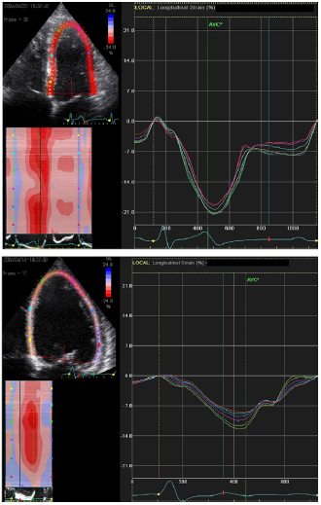
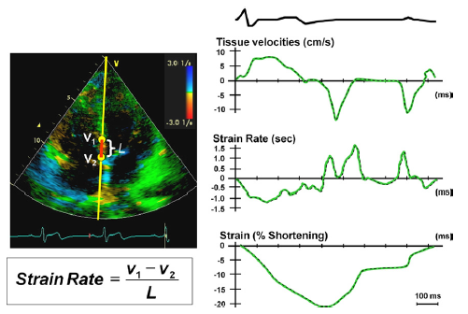

Slide 87
Surrogate Measurements Of LV stiffness
DT of mitral E velocity.
DT is proportional to the inverse square root of LV stiffness, provided LA pressure is constant.
Mitral inflow velocities- E/A ratio <1 and DT >240 ms have high specificity for abnormal LV relaxation.
Tissue Doppler annular signals- Tissue Doppler e´ is a more sensitive parameter.
Lateral e´ <8.5 cm/s and septal e´<8 cm/s have impaired myocardial relaxation
Colour M-Mode Vp- Normal Vp is 50 cm/s and correlates with the rate of myocardial relaxation

Slide 88
DIASTOLIC STRESS TEST
Detect reduced LV systolic and/or diastolic reserve capacity in the setting of diastolic dysfunction
Normal subjects: Increase stroke volume without significantly increasing filling pressures
HFpEF: Cannot augment myocardial relaxation with exercise compared with normal subjects.
Cardiac output achieved at the expense of increased LV filling pressures
Indicated when resting echocardiography does not explain the symptoms of heart failure or dyspnoea, especially with exertion
Most appropriate patient population for diastolic exercise testing is the group of patients with grade 1 diastolic dysfunction, which indicates delayed myocardial relaxation and normal LA mean pressure at rest.

Slide 89
DIASTOLIC STRESS ECHO

Slide 90
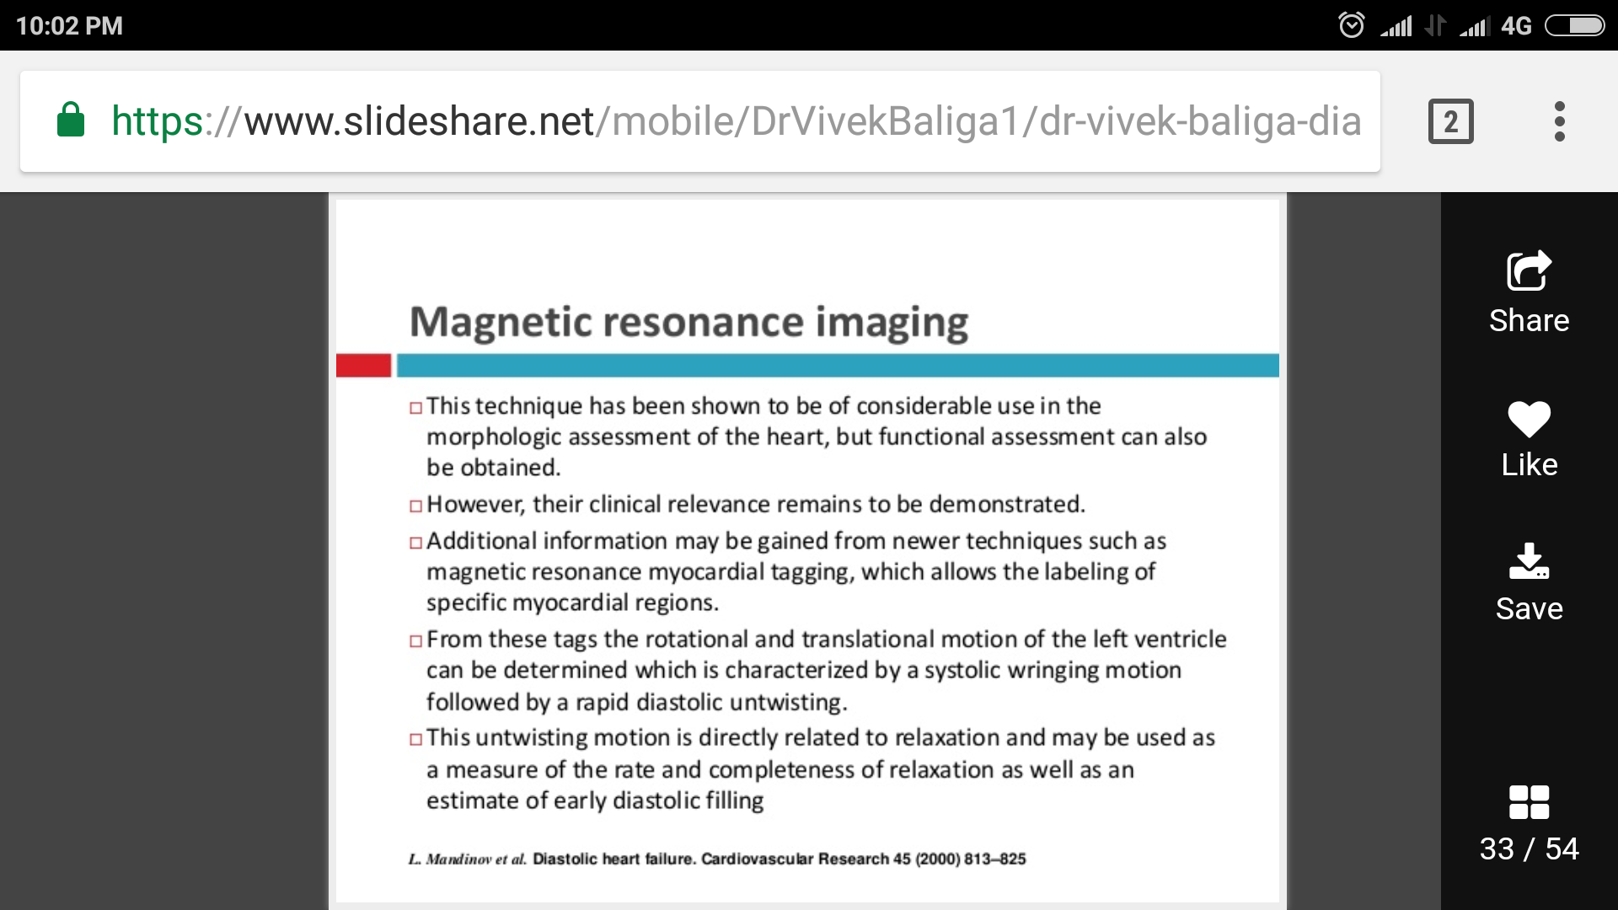
MAGNETIC RESONANCE IMAGING

Slide 91
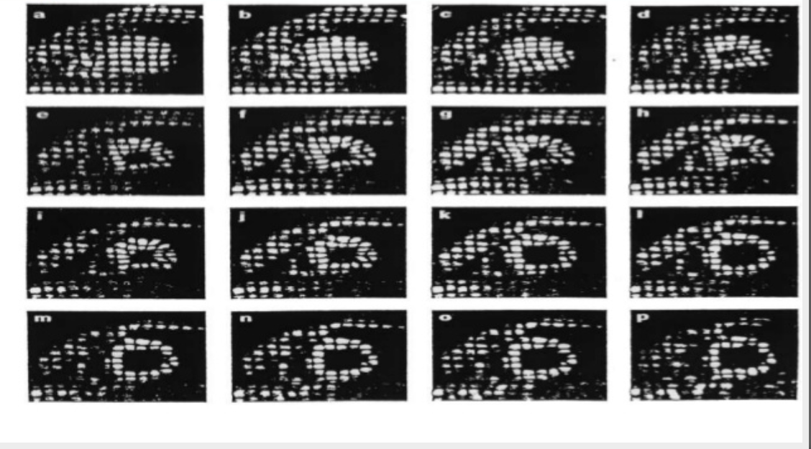

Slide 92
How to treat it?
MANAGEMENT OF HFpEF

Slide 93
Pathophysiological Targets
Randomized Clinical Trials
Guidelines

Slide 94
Pathophysiological Targets
1) Reduction and prevention of pulmonary and peripheral venous congestion
fluid and sodium restriction, judicious use of diuretics and nitrates, selective application of neurohormonal modulation, and appropriate remote monitoring–based tailored care
2) Treatment of antecedent and comorbid diseases
controlling blood pressure at rest and modifying blood pressure response to exercise, controlling glucose, treating and preventing ischemia, maintaining adequate renal function, and treating obesity
3)optimization of cardiac functional status
prevent excessive tachycardia or bradycardia

Slide 95
Randomized Clinical Trials

Slide 96
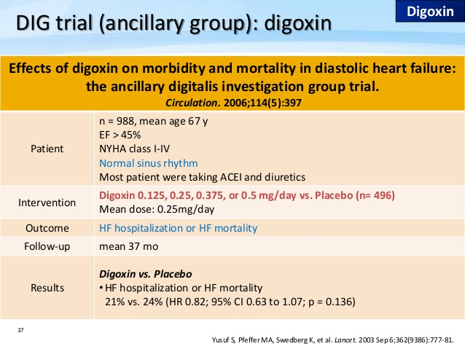
Notes:
digoxin did not alter the primary endpoint of HF-related hospitalization or CV mortality but did reduce the number of such hospitalizations.

Slide 97
Heart failure hospitalization or heart failure mortality
0
.
5
2-year
HR 0.71
95% CI 0.52-0.98
P=0.034
0
.
4
0
.
3
% Events
0
.
2
Placebo
Overall
HR 0.82
95% CI 0.63-1.07
P=0.136
0
.
1
Digoxin
0
.
0
0
1
2
2
4
3
6
4
8
Months
CV Hospitalization or Mortality NO DIFFERENT
↑ in Unstable Angina
Ahmed A et al, Circ, 2006

Slide 98
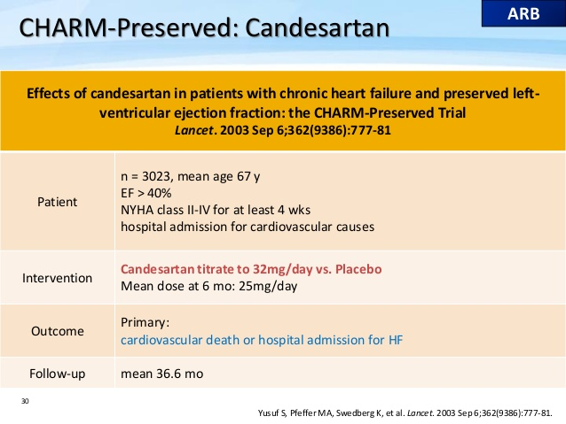

Slide 99
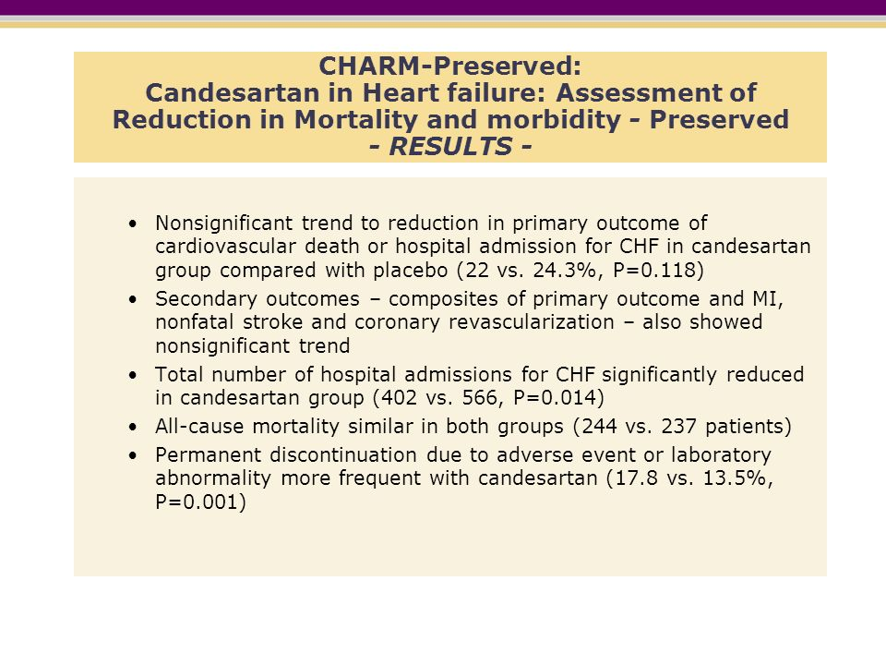
Notes:
reduced hospitalization

Slide 100
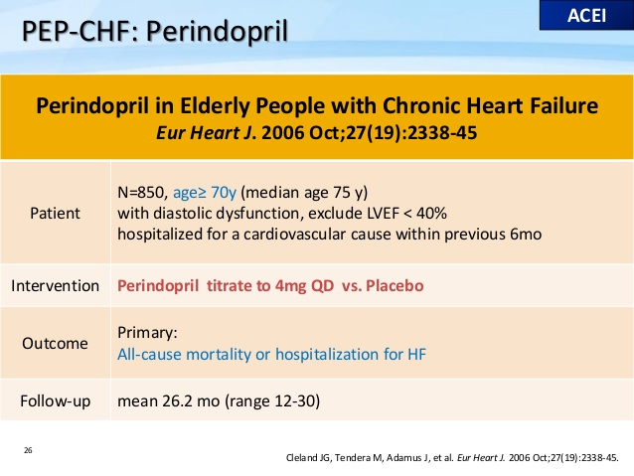

Slide 101
`

Slide 102
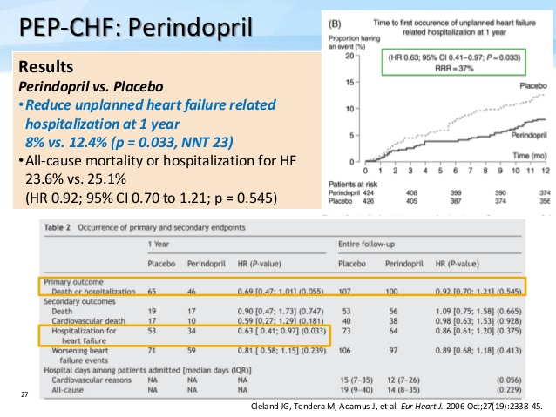

Slide 103
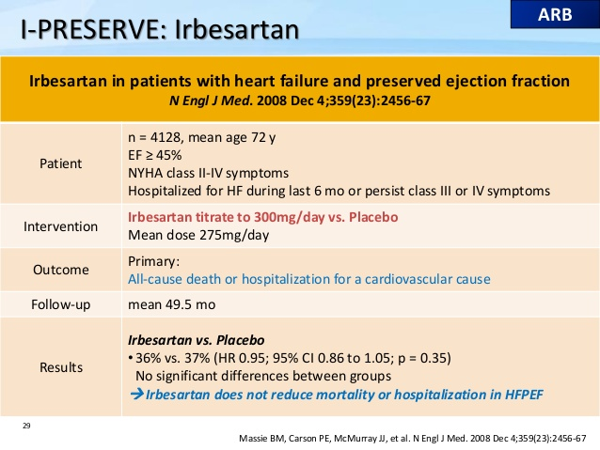

Slide 104
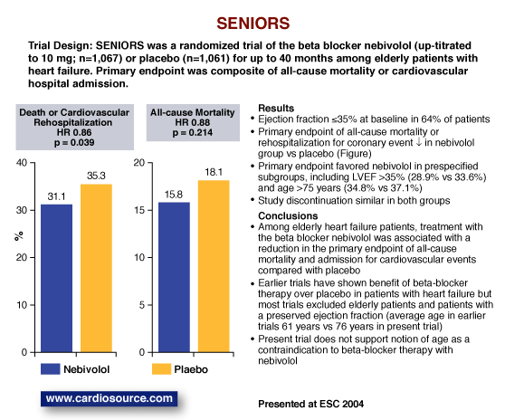
Notes:
very few patients with EF above 50% were included in the trial. Thus it is not possible to draw conclusions about the benefit of beta blockers in
HFpEF from this study

Slide 105
HEAT HFPEF
Background
Nitrates are commonly prescribed to enhance activity tolerance in patients with heart failure and a preserved ejection fraction. We compared the effect of isosorbide mononitrate or placebo on daily activity in such patients.
Methods
In this multicenter, double-blind, crossover study, 110 patients with heart failure and a preserved ejection fraction were randomly assigned to a 6-week dose-escalation regimen of isosorbide mononitrate (from 30 mg to 60 mg to 120 mg once daily) or placebo, with subsequent crossover to the other group for 6 weeks. The primary end point was the daily activity level, quantified as the average daily accelerometer units during the 120-mg phase, as assessed by patient-worn accelerometers. Secondary end points included hours of activity per day during the 120-mg phase, daily accelerometer units during all three dose regimens, quality-of-life scores, 6-minute walk distance, and levels of N-terminal pro–brain natriuretic peptide (NT-proBNP).
Results
In the group receiving the 120-mg dose of isosorbide mononitrate, as compared with the placebo group, there was a nonsignificant trend toward lower daily activity (−381 accelerometer units; 95% confidence interval [CI], −780 to 17; P=0.06) and a significant decrease in hours of activity per day (−0.30 hours; 95% CI, −0.55 to −0.05; P=0.02). During all dose regimens, activity in the isosorbide mononitrate group was lower than that in the placebo group (−439 accelerometer units; 95% CI, −792 to −86; P=0.02). Activity levels decreased progressively and significantly with increased doses of isosorbide mononitrate (but not placebo). There were no significant between-group differences in the 6-minute walk distance, quality-of-life scores, or NT-proBNP levels.
Conclusions
Patients with heart failure and a preserved ejection fraction who received isosorbide mononitrate were less active and did not have better quality of life or submaximal exercise capacity than did patients who received placebo. (Funded by the National Heart, Lung, and Blood Institute; ClinicalTrials.gov number, NCT02053493.)

Slide 106
STATINS
Statins, as anti-inflammatory agents : first-line therapy in CAD and hyperlipidemia
CORONA (Controlled Rosuvastatin Multinational Trial in Heart Failure) trial : neutral regarding the efficacy of statins in patients with HFREF.
Fukuta et al: significant relative risk reduction in mortality in HFPEF (LVEF > 50%) pts with statin for 21months.
270 patients with HFPEF, follow-up for 5 years - improved survival compared to patients without statin therapy (HR= 0.65; 95%CI: 0.45-0.95, P = 0.029). - survival benefit was maintained after adjusting for differences in baseline characteristics, comorbidities, and other medications
Some small observational studies : seems to be associated with improved survival benefit in pts with HFPEF

Slide 107
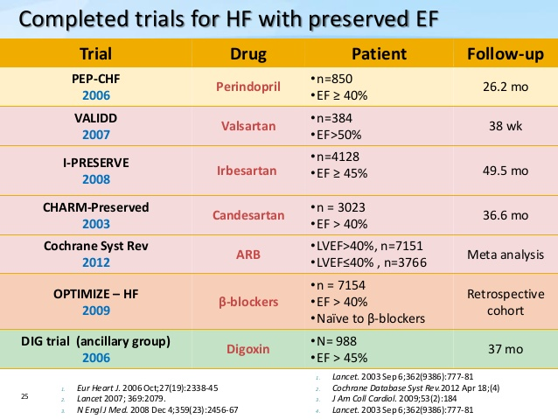

Slide 109
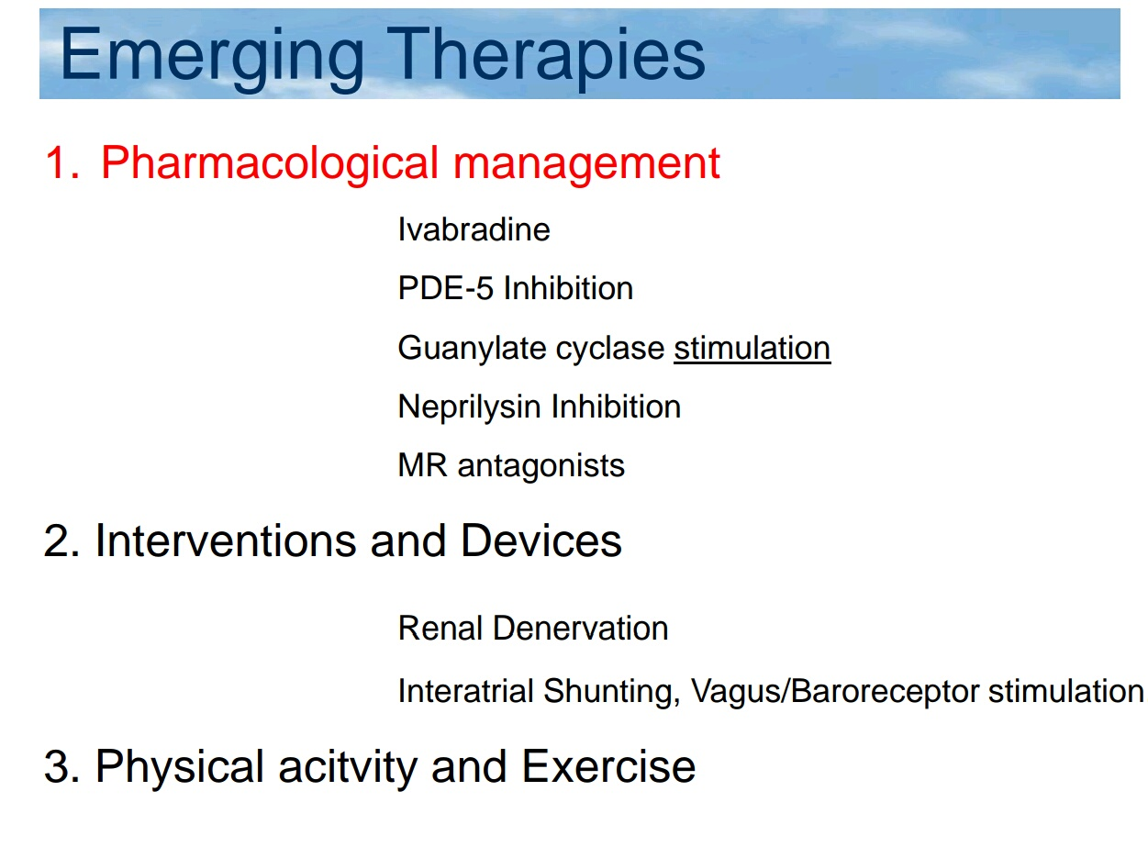

Slide 110
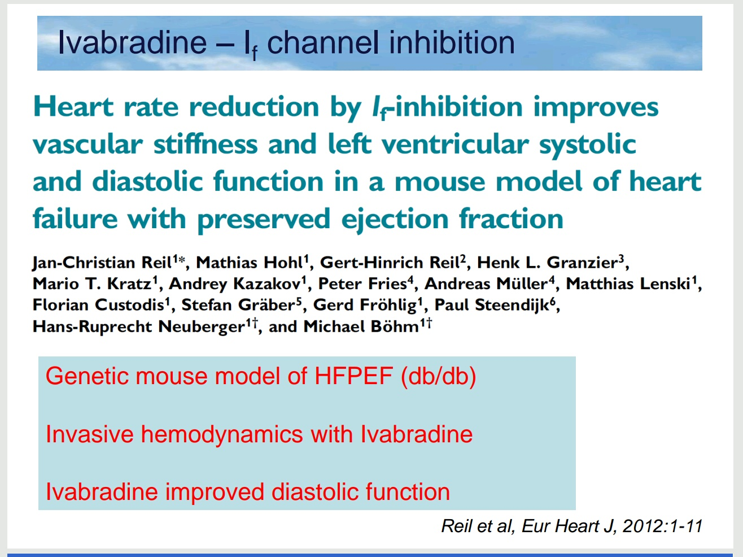

Slide 111
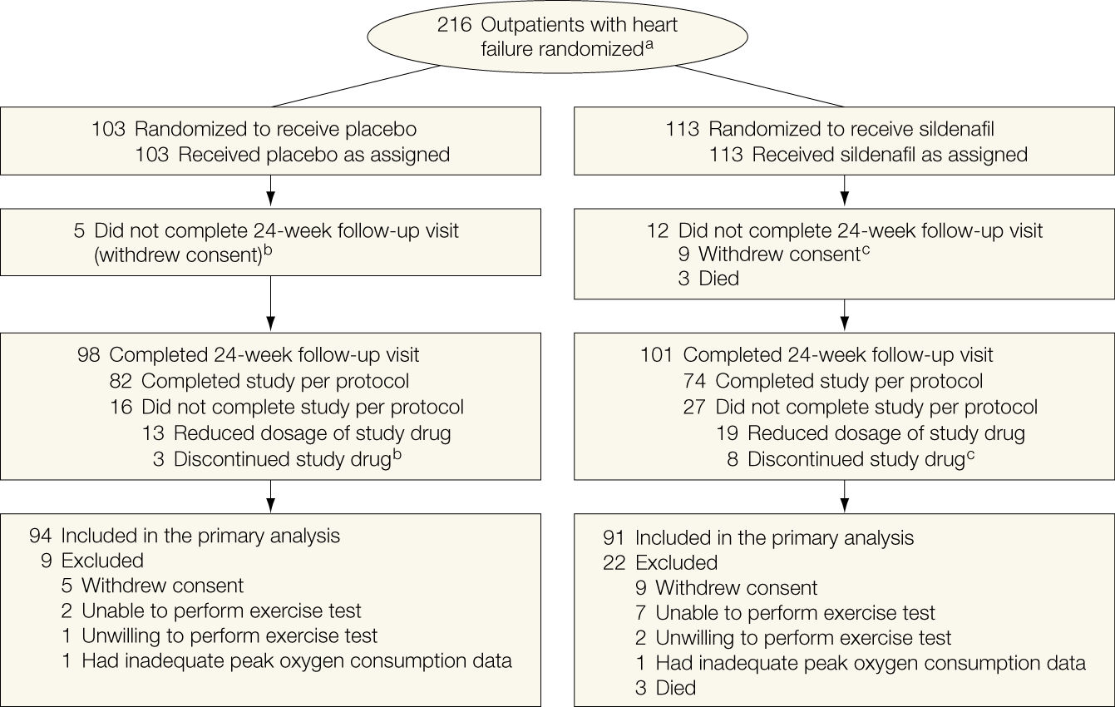
RELAX HF

Slide 112
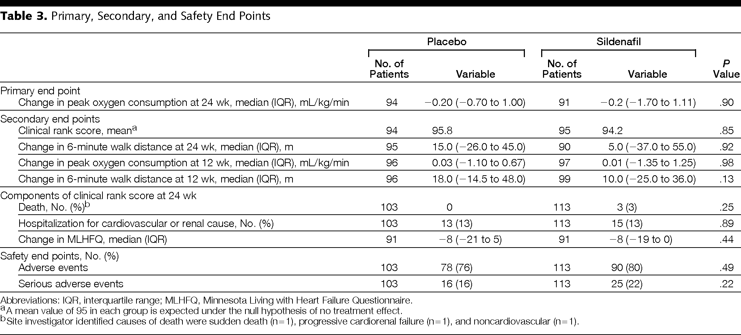

Slide 113
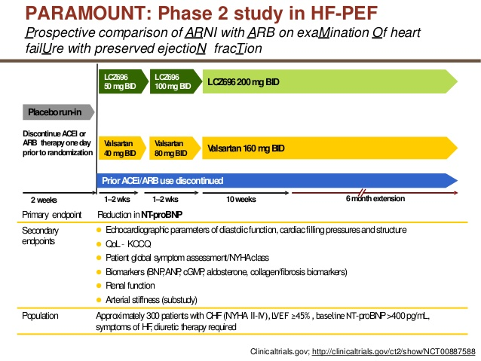

Slide 114
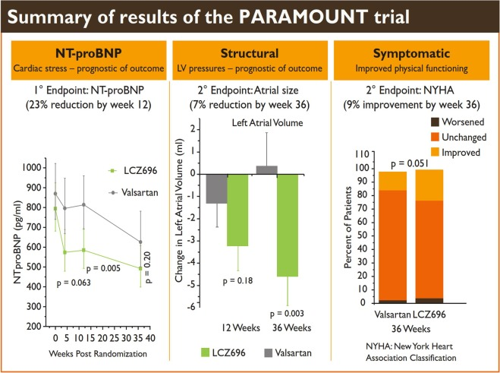
Lancet. 2012 Oct 20;380(9851):1387-95. doi: 10.1016/S0140-6736(12)61227-6

Slide 115
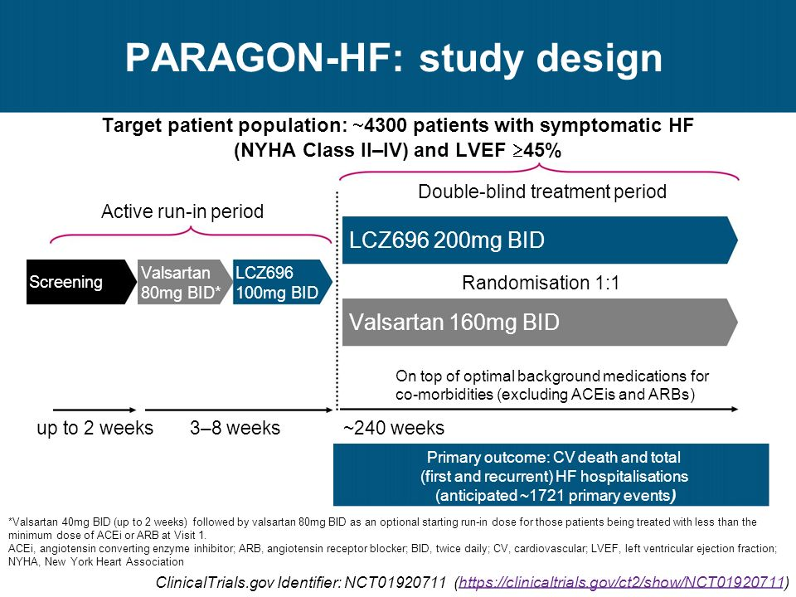

Slide 116
TOPCAT: Trial Design
    AGE ≥ 50 YRS
    EF ≥ 45% WITHIN 6 MONTHS
    HEART FAILURE SYMPTOMS AND SIGNS
    CONTROLLED SYSTOLIC BP (< 140 mm Hg)*
    SERUM K⁺ ≤ 5.0 MMOL/L
PLUS ONE OF THE FOLLOWING:
    HF HOSPITALIZATION WITHIN 12 MONTHS OR
    BNP ≥ 100 PG/ML
    N-TERMINAL PRO-BNP ≥ 360 PG/ML
N=4500
RANDOMIZE
PLACEBO
15 MG
SPIRONOLACTONE 15 MG
Week 0
DOSE TITRATION (TARGET 30 MG)
* Optional Titration to 45 mg at 4 mos
Week 4
COMPOSITE PRIMARY ENDPOINT
CV death, Aborted cardiac arrest, Hospitalization for HF
~ 3.25 yrs

Slide 117
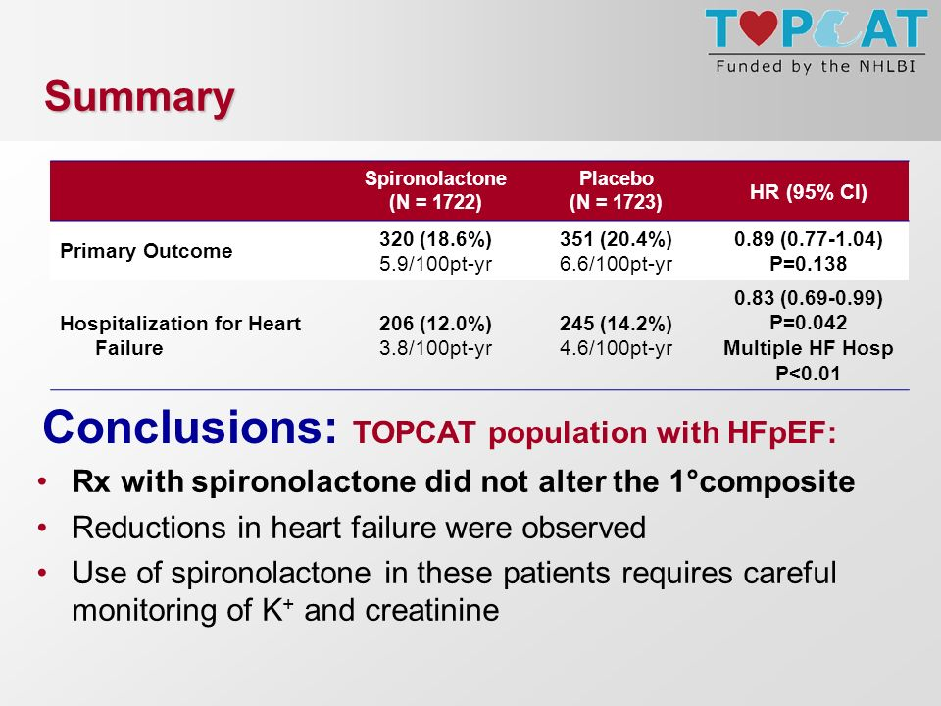

Slide 118
COMPASS-HF trial
70 patients with HFpEF (with EF >50%) were studied using an IHM that measured an estimated pulmonary artery diastolic pressure (ePAD), a measurement that in the absence of pulmonary vascular disease approximates PCWP
This study demonstrated
patients with HFpEF demonstrated significantly increased filling pressures even while they were considered to be in a compensated state by their physicians
these pressures rose further when they became decompensated
(3) both baseline pressures and change from baseline pressures predicted outcomes, including the rates of HF hospitalization and CV

Slide 119
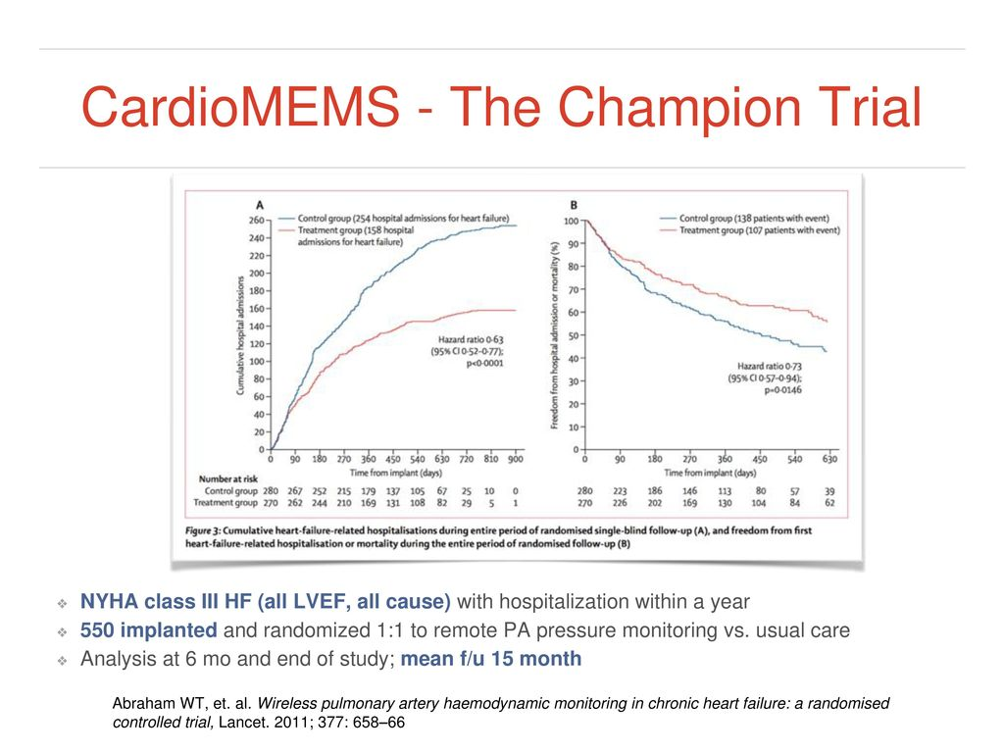
Notes:
active treatment arm demonstrated a 152% decrease in pulmonary artery diastolic and systolic pressures and a 52% decrease in HF-related events (both P < 0.0001 and control) and a decrease in CV mortality rate

Slide 120
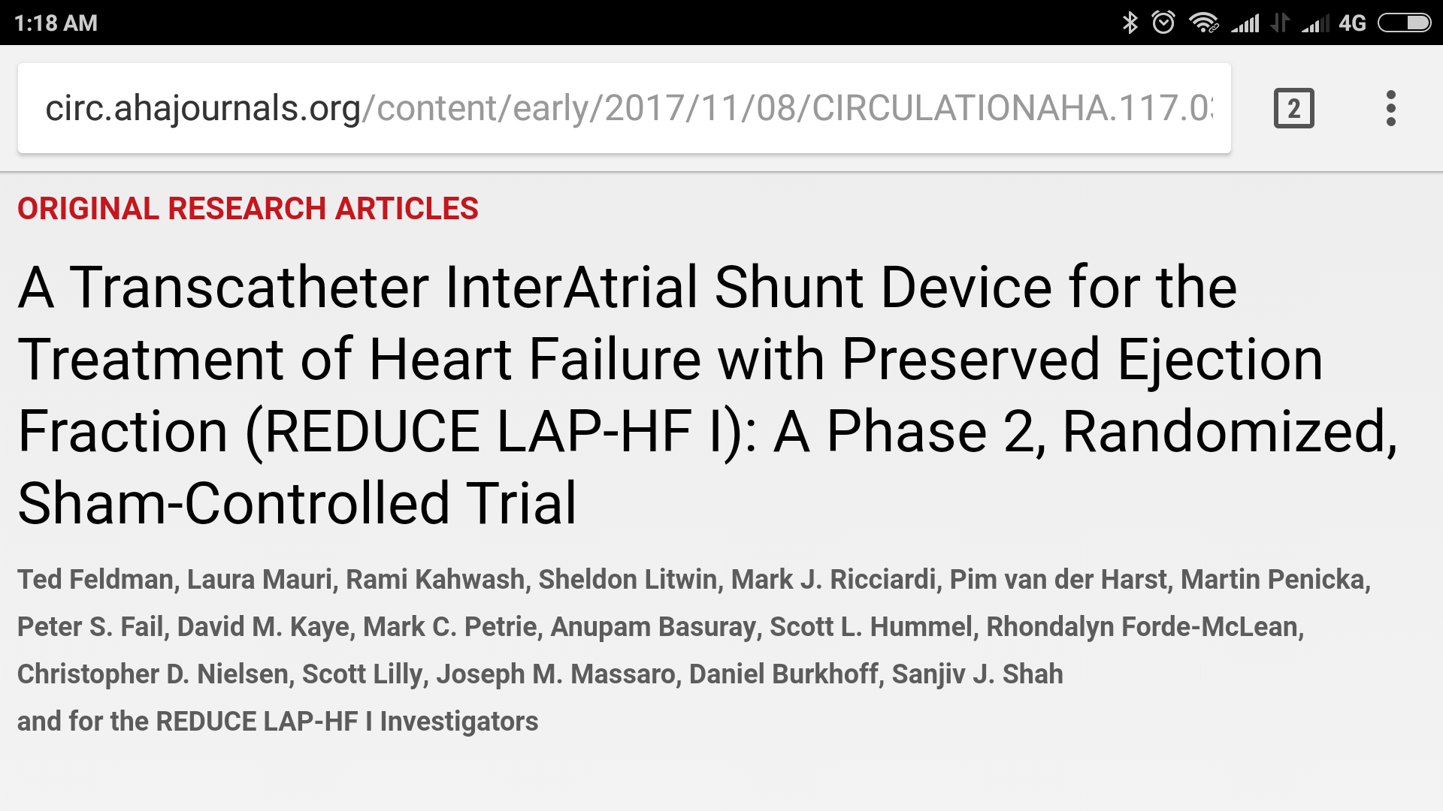
Conclusions—In patients with HF and EF ≥ 40%, IASD treatment reduces PCWP during exercise. Whether this mechanistic effect will translate into sustained improvements in symptoms and outcomes requires further evaluation.

Slide 121
Treatment of Comorbid Conditions
AF patients should receive anticoagulation
Hypertension – diuretics, aceI , arb ,ccb
Diabetis – metformin 1st choice

Slide 123
FUTURE PERSPECTIVE
Treatments that
restore calcium homeostasis
change the phosphorylation state of titin
reduce ECM fibrosis
normalize natriuretic peptide levels
multitargeted approach is necessary because each mechanism, independent of other mechanisms, probably contributes to disease progression

Slide 124
MCQ

Slide 125
1
Which is the true statement regarding of HFpEF?
LA volume index >34 mL/m² is an independent predictor
Right heart catheterization is gold standard
PCWP >= 15 mmHg and LVEDP >= 16mmHg
HFpEF have reduced distensibility, indicated by a elevated end-diastolic volume and end-diastolic pressure

Slide 126
2
Diastolic pressure-volume relationship (DPVR) in patients with HFpEF is shifted ……………..
Upward and right
Upward and left
Downward and right
Downward and left

Slide 127
3
Non invasive supportive evidence of HFpEF are
E’ > 9 cm/ s
E/e’ <= 15
GLS < 16
TR Vel > 2.8 m/s

Slide 128
4.Match the following trials
PEP CHF TRIAL PDE5
RELAX TRIAL ACEI
I PRESERVE TRIAL ARB
TOPCAT ARNI
PARAGON HF MRA

